Slide 2
Setting the stage: The Application Platform in Windows Server 2016
B875
Andrew Mason and Taylor Brown
Principal Lead Program Managers
@taylorb_msft

Slide 3
Tenets of Development
Develop – minimize your dependencies
Package – know your dependencies
Configure – use intent based configuration
Deploy – use modular, componentized deployments
Run – use physical hosts, VMs, or containers
Test – use unit tests
Secure – don’t let security be an after thought or add-on

Slide 4
Operational Models
In previous releases Windows Server hasn’t had a point of view
Variety of artifacts used
No clear set of choices or recommendations
Windows Server 2016 has a clear point of view
Traditional ops model
Emerging model with Containers

Slide 5
Windows Server 2016 resolves the interface between devs and ops

Slide 6
Windows Server App Platform
Develop apps using SDK targeting Nano Server
Package apps using Windows Server App (WSA) installer
Configure apps using DSC
Deploy apps and dependencies using Package Management
Run apps in physical, VMs, or containers
Test apps using Pester
Secure apps using Just enough Administration (JEA)
Architectural Foundation

Slide 7
Containers in Windows Server
Develop apps using Frameworks on Nano Server
Package apps as Container Images pushed to repositories
Configure apps using Container Images
Deploy container images from repositories
Run containers though orchestrators
Test apps using your test frameworks
Secure apps using multiple containers and JEA

Slide 8
Developing Apps Targeting Nano Server

Slide 9
Nano Server: just enough OS
Optimized for next-gen distributed applications
Higher density and Reduced attack surface and servicing requirements
Next-gen distributed app frameworks
Interoperate with existing server applications
Third-party applications
RDS experience
Traditional VM workloads
Containers and next-gen applications
Full GUI
Specialized workloads
Server Core
Lower maintenance server environment
Nano Server
Just enough OS

Slide 10
Nano Server: Next step in our cloud journey
Zero-footprint model
Server Roles and Optional Features live outside of Nano Server
Standalone packages that install like applications
Key Roles & Features
Hyper-V, Storage (SoFS), Clustering, IIS, and DNS Server
.NET Core and ASP.NET Core
Full Windows Server driver support
Antimalware optional package
System Center VMM and OM agents available

Slide 11
Nano Server - Cloud Application platform
Born-in-the-cloud application support
Subset of Win32
.NET Core and ASP.NET Core
PowerShell Desired State Configuration (DSC)
PackageManagement (aka OneGet)
Open Source Application Frameworks
Available as OS everywhere
Host OS for physical hardware
Guest OS in a VM
Windows Server Containers
Hyper-V Containers

Slide 12
Nano Server - Developer Experience
Nano Server has a full developer experience, unlike Server Core
Windows SDK & Visual Studio 2015 target Nano Server
Rich design-time experience
Project template, full IntelliSense, error squiggles, etc.
Full remote debugging experience

Slide 13
Server Application Development
Deep refactoring
Client stack for RDS
Developers target Nano Server
Deploy to Physical, Virtual or Containers
Remote Desktop Server
Local Admin Tools
Client
(aka Server w/a Desktop Exp)
(Aka Full Server)
Physical, Virtual, Containers
Server Core
Nano Server

Slide 14
Porting Existing Apps to Nano Server
Say hello to Reverse Forwarders!
A missing DLL will result in your code failing to run
Provide a way to run existing code without recompiling code for Nano Server
With Reverse Forwarders, your code will load and API calls in those DLLs will either result in
API call succeeding if the API is in the Nano Server boundary
Return of “Not Implemented exception” if it is not within the Nano Server boundary
Does not eliminate the need to refactor code to what is available in Nano Server

Slide 15
Reverse Forwarders
Optional package that can be included in a Nano Server image when needed in TP4 and earlier
Available reverse forwarders include:
advapi32.dll
comctl32.dll
comdlg32.dll
gdi32.dll
kernel32.dll
ole32.dll
psapi.dll
secur32.dll
setupapi.dll
shell32.dll
shlwapi.dll
tdh.dll
user32.dll
version.dll
winmm.dll

Slide 16
What runs today with Reverse Forwarders?
Chef
PHP
Nginx
Python 3.5
Node.js
GO
Redis
MySQL
OpenSSL
Java (OpenJDK)
Ruby (2.1.5)
SQLite

Slide 17
Creating/Porting Application to Nano Server
Use Reverse Forwarders to test your app
For Native code
Use Visual Studio Nano Server project template to create a new Nano Server application
Or, use NanoServerApiScan.exe - http://blogs.technet.com/b/nanoserver/archive/2015/11/16/native-binary-scanning-tool-nanoserverapiscan-exe-for-nano-server.aspx
For Managed code
Refactor your code to .NET Core
API Portability Analyzer - http://www.microsoft.com/en-us/download/details.aspx?id=42678

Slide 18
Demo APIScan
Andrew Mason

Slide 19
Containers and Nano Server

Slide 20
Windows Server Containers
Container Host
System Processes
Session Manager
Container Management
Local Security Authority
Windows Server Container
Windows Server Container
Docker Engine
Event Manager…
System Processes
Application Processes
System Processes
Application Processes
Compute Services
Etc…
Windows Kernel

Slide 21
Hyper-V Containers
Container Host
System Processes
Virtual Machine Specifically Optimized To Run a Container
Session Manager
Hyper-V Container
Container Management
Local Security Authority
Windows Server Container
Docker Engine
Guest Compute Service
Event Manager…
System Processes
Application Processes
Compute Services
Basic System Processes
Etc…
Windows Kernel
Windows Kernel
Hyper-V Hypervisor

Slide 22



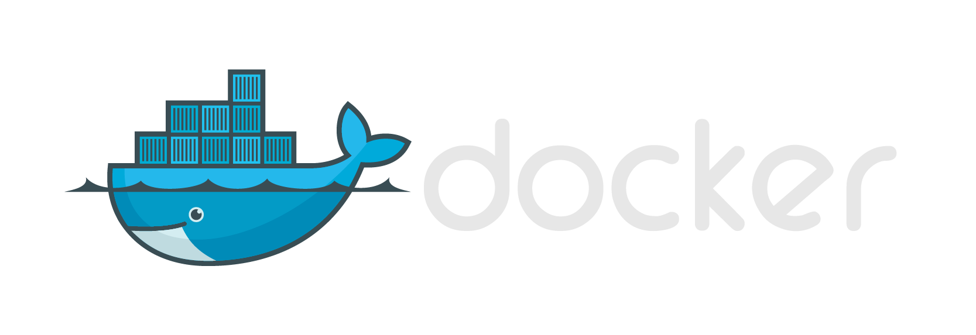



Same Container Images, Same API
Windows Container Images
Container Run-Times
Hyper-V Container
Container Management
Docker
Application
Framework
Windows Server Container
Write once, deploy anywhere

Slide 23
Operating System Deployment Modes
Windows Server Containers
Container must match host (i.e. Nano on Nano) will be relaxed in the future…
Hyper-V Containers
Container must be Nano Server. Server Core support coming…
Host can be Nano Server, Windows Server Core or Windows Server w/Desktop
Container
Container
Container Host
Container Host
Nested Virtual Machine
Virtual Machine Host
Physical Server
Physical Server

Slide 24
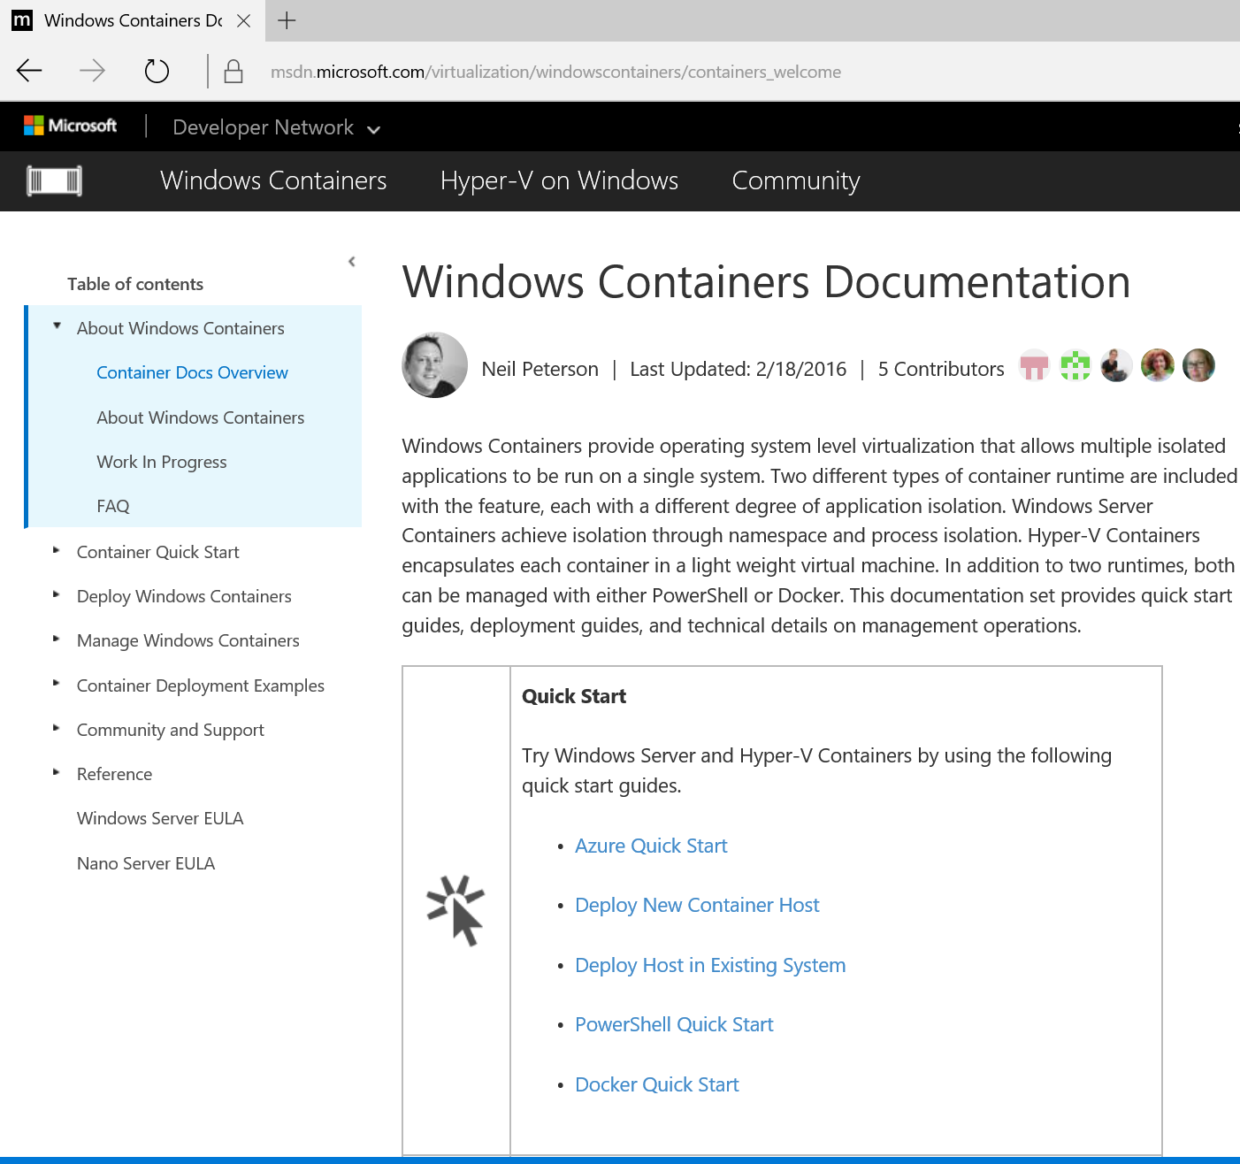
Where To Run Containers
Azure
Windows Server 2016 TP4 Image In Marketplace
Only Windows Server Containers
Existing Server/Physical or VM
Install Windows Server 2016 TP4
Windows Server and/or Hyper-V Containers
Nested Virtualization on Hyper-V
VM on Windows 10 or Windows Server 2016 TP4
Windows Server and/or Hyper-V Containers

Slide 25
Announcing: Hyper-V Containers coming to Windows 10

Slide 26
Demo Nano Server and Hyper-V Containers
Taylor Brown

Slide 27
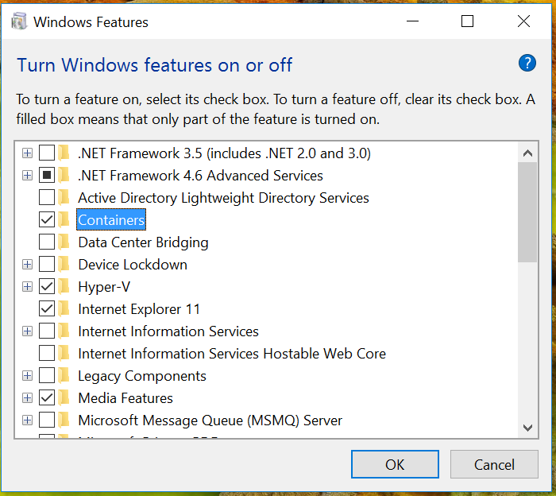
Windows 10 and Hyper-V Containers
Platform support in Windows Insider builds
Enable the “Containers” and “Hyper-V” Feature
Nano Server Only
Windows Server Core support coming…
Docker Engine and Container OS Image available along with Windows Server 2016 Technical Preview 5 soon…
See http://aka.ms/containers

Slide 28
Packaging apps using Windows Server App (WSA) installer

Slide 29
MSI is not supported on Nano Server
Can’t just port MSI to Nano Server
MSI has significant GUI dependencies
Custom Actions allow for any code to be run
Reliability
Custom Actions can be fragile
No guarantee that uninstall actually removes all installed assets, potentially leaving the system in an unknown state

Slide 30
Windows Server App (WSA) installer
A new Server installer based on declarative APPX
Declare install actions in a manifest
Promotes Server specific install actions to first class citizens
Allows intra package dependencies
Not specific to Nano Server
Will be available in Server Core and Server with Desktop Exp
Extends the AppX schema
Allows for Server specific Extensions, such as NT Services

Slide 31
Windows Server App (WSA) Installer (cont.)
Developers describe Server Extensions in the WSA manifest
Supports online install
Roadmap includes plans to support offline install (post Windows Server 2016)
Does not allow custom code during installation
More consistent and reliable installs and uninstalls

Slide 32
Declarative Server Application
Files and Registry
Server Extensions
NT Services
COM Objects
WMI
Performance Counter*
ETW events*
* - additions in the next Technical Preview

Slide 33
When to use WSA
Need to support installation on Nano Server
Installation involves system/OS level changes
Requirements to
Support Uninstall and Servicing
Declare dependency on Windows features or framework packages (post Windows Server 2016)
When not to use WSA, must
Have a GUI
Take interactive user input
Run custom code

Slide 34
WSA Packaging and Installation
WSA Packaging
Author Manifest file
Use MakeAppx.exe to create the WSA (.appx) package
Digitally sign. E.x. signtool.exe sign xxx.appx
Requires Windows SDK
WSA Installation
Using AppX cmdlets
Copy the WSA package to Nano Server
Add-AppxPackage
Using PackageManagement cmdlets
Add WSA package source with Register-PackageSource
Install-Package

Slide 35
Demo WSA
Andrew Mason

Slide 36
WSA Resources
WSA Introduction: http://blogs.technet.com/b/nanoserver/archive/2015/11/18/installing-windows-server-apps-on-nano-server.aspx
WSA deep dive: http://blogs.technet.com/b/nanoserver/archive/2015/11/19/hands-on-packaging-and-installing-your-first-windows-server-apps-on-nano-server.aspx
Questions and feedback- nanoserver@microsoft.com
FireGiant and WiX Tool: https://www.firegiant.com/wix/appx/
Provides commercial support for the WIX toolset and support the WIX community
Created a commercial tool for WiX that will allow you to generate a WSA in addition to an MSI

Slide 37
Drivers on Nano Server
Not supported by WSA in Windows Server 2016, drivers remain INF-based
PnP Drivers
PnP drivers can be offline installed using INF via DISM
Online install driver will be available in Windows Server 2016
File system and minifilter Drivers
Expanding INF syntax to support file system and minifiter drivers on Nano Server
Offline install will be available in Windows Server 2016
Online install will be available post Windows Server 2016

Slide 38
Building Container Based Applications

Slide 39
Container Image
Docker Image
What is a container image?
Templates for containers
Read-only
File based
The Docker Implementation
Metadata
Layers
Creation
Manually
Automated with a dockerfile
Pulled from a registry
Image metadata (json)
Layer-1
Layer metadata (json)
Layer payload (tar)
Layer-2
Layer metadata (json)
Layer payload (tar)
Layer-x
Layer metadata (json)
Layer payload (tar)

Slide 40

Dockerfile
Method for automated container image creation
Consumed when running “docker build”
Enables automated builds via docker hub
Caches unchanged commands
IIS Image
FROM nanoserver
ADD unattend.xml /unattend.xml
ADD packages /packages
RUN dism /online /apply-unattend:.\unattend.xml
WebApp Image
FROM iis
ADD mysite.htm inetpub\mysite.html
Mysite.html
Sandbox
Layer 2
microsoft/iis
Sandbox
Layer 1
Container OS
Image

Slide 41
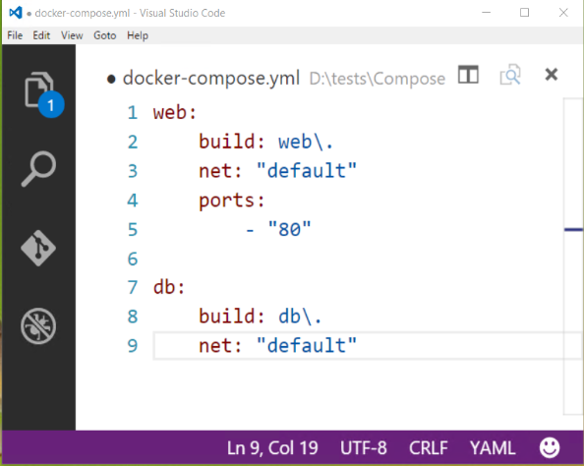
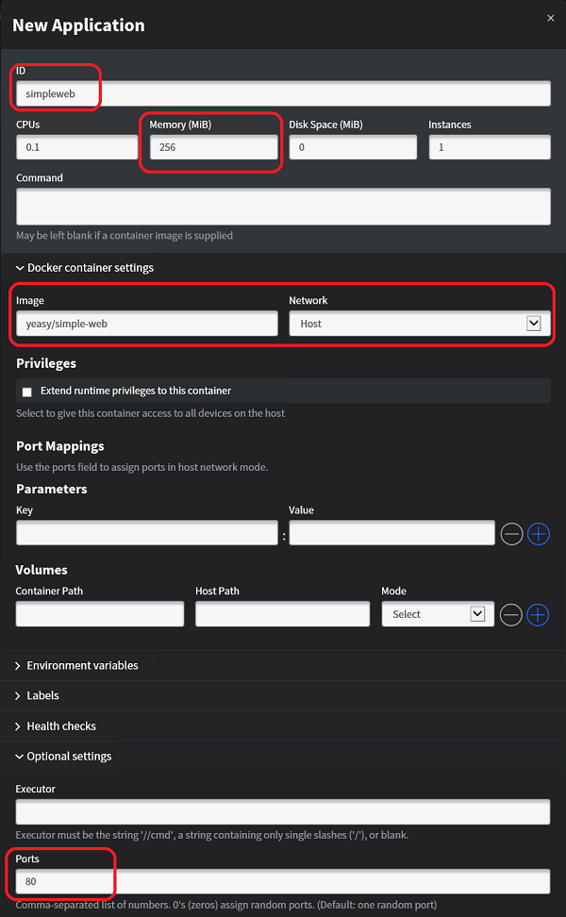
Composition and Orchestration
Docker
Compose
Defines a multi-container application
Start/stop all containers via a single command
Scale independent allocation tiers
Swarm
Aggregates container hosts
Supports tagging, affinity/anti-affinity
Mesos/Mesosphere + Marathon
Aggregates container hosts
Web based UI
Service Launch and Discovery
Utilizes the docker command line

Slide 42
Demo Docker Compose
Taylor Brown

Slide 43
Announcing: PowerShell For Docker!

Slide 44
PowerShell For Docker
Docker Client
Docker Compose
Docker Registry
Docker Swarm
Docker Engine
Operating System

Slide 45
PowerShell For Docker
Docker Client
PowerShell
Docker Compose
Docker Registry
Docker Swarm
Docker Engine
Operating System

Slide 46
PowerShell For Docker
Soon to be released open source
Builds on the Docker Engine’s REST Interfaces
Will replaces the existing container module
We need you!
Windows PowerShell
Copyright (C) 2016 Microsoft Corporation. All rights reserved.
PS C:\> New-Container
PS C:\> Get-Container
PS C:\> Get-ContainerImage
Docker Client
PowerShell
Docker Compose
Docker Registry
Docker Swarm
Docker Engine
Operating System

Slide 47
Windows Server 2016 resolves the interface between devs and ops

Slide 48
Windows Server App Platform
Develop apps using SDK targeting Nano Server
Package apps using Windows Server App (WSA) installer
Configure apps using DSC
Deploy apps and dependencies using Package Management
Run apps in physical, VMs, or containers
Test apps using Pester
Secure apps using JEA
Call to Action
Target Nano Server
Create WSAs
Deploy using Package Management
Give us feedback on:
Missing Reverse Forwarders
Installer functionality needed in WSA
Package Management
nanoserver@microsoft.com
https://windowsserver.uservoice.com/forums/295047-general-feedback

Slide 49
Containers in Windows Server
Develop apps using Frameworks on Nano Server
Package apps as Containers or as WSA
Configure apps using Containers
Deploy apps and dependencies using Containers or packages
Run apps in containers
Test apps using your test frameworks
Secure apps using multiple containers and JEA
Call to Action
Learn more about Windows containers http://aka.ms/containers
Give your apps a try in Windows containers
Help with PowerShell for Docker
Get ready for Technical Preview 5!
Continue providing feedback and bug reports
http://aka.ms/containers/forum
https://github.com/Microsoft/ Virtualization-Documentation
https://github.com/docker/docker

Slide 50

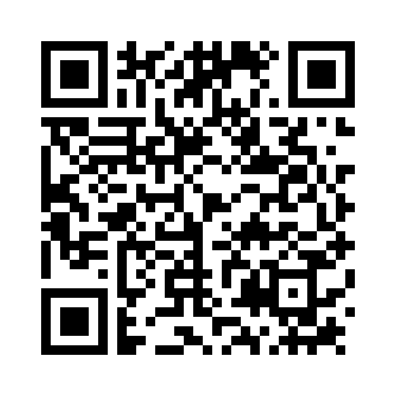

Please Complete An Evaluation Form Your input is important!
Required Slide
*delete this box when your slide is finalized
or

Slide 52
Appendix – PackageManagement, DSC, Pester, and JEA

Slide 53
Deploying apps and their dependencies using Package Management

Slide 54
PackageManagement (a.k.a. OneGet) Architecture
End User
PackageManagement Core
Inventory
PackageManagement Providers
Windows Server App (WSA)
PowerShellGet
Discovery
Windows Container
NuGet
…
Package Sources
WSA Package Repository…
WordPress, …
PackageManagement PowerShell cmdlets
Install/Uninstall
PowerShell Gallery
NuGet Gallery …
Container Gallery, Docker
www.NPMjs.com
NanoServerPackage

Slide 55
PackageManagement Experience
Provides PowerShell experience for package operations
Find-package: search a software package
Install-package: install the package
Save-package: download the package
Get-package: inventory what packages are installed
Uninstall-package: uninstall

Slide 56
PackageManagement Experience - continued
Offers PS cmdlets to manage package repositories
Register-packageSource: connect to a repository
Other cmdlets on packageSource: Get-, set-, unregister-
Offers plug-in model to install providers on-demand
A provider is an installer wrapper plug-in to PackageManagement, dealing with its own package format
Install-packageProvider: install a provider on-demand
Other cmdlets on packageProvider: find-, get-, import-

Slide 57
The Providers on Nano Server
PowerShellGet is the only inbox provider
Manages PowerShell modules and scripts from the PowerShell Gallery
Uses NuGet protocol provider
WSA provider
Provides general OneGet cmdlets that wrap AppX cmdlets
ContainerImage provider
Provides search/install/download of Container-base WIM images
NanoServerPackage provider
Provides search/install/download optional Windows Packages to Nano Server

Slide 58
PackageManagement Resources
Documentation
https://technet.microsoft.com/en-us/library/mt422622.aspx
PackageManagement and NuGet provider source are in Github
http://oneget.org
Downlevel OS support, including PackageManagement and PowerShellGet provider
WMF 5.0 RTM - https://www.microsoft.com/en-us/download/details.aspx?id=50395

Slide 59
Configuring apps using Desired State Configuration (DSC)

Slide 60
Desired State Configuration
Cloud scale configuration management
Declare the state of a server (Ensure Service is Started)
Apply expert knowledge as common tasks – easier than scripting
DSC is the platform
Works in collaboration with DevOps tool chain (Chef, Puppet, etc.)
Windows 2008R2 and later, and Linux via OMI
Experimental DSC Resources bundled into DSC Resource Kit
https://gallery.technet.microsoft.com/scriptcenter/DSC-Resource-Kit-All-c449312d
DSC Resources
https://msdn.microsoft.com/en-us/powershell/dsc/overview

Slide 61
Testing Apps Using Pester

Slide 62
Pester
Test framework for PowerShell functions, cmdlets, modules, and scripts
Easy to learn, easy syntax, powerful mock capabilities and integrates with CI solutions
Origin as Community Open Source project
Shipping in Windows 10 and above
Adopted internally at Microsoft
https://github.com/pester/Pester

Slide 63
Securing apps using Just Enough Admin (JEA)

Slide 64


Problem: system admin privileges
Michael Hayden
Four star general
Director of the NSA
Director of the CIA
Director of National Intelligence
Edward Snowden
Age 30
College dropout
You’re an Admin
Thanks, you’re PWND!!
… but admins are often not suspected of criminal activity – they are simply targeted because they control access to networks the attacker wants to infiltrate. “Who better to target than the person that already has the ‘keys to the kingdom’?”

Slide 65
From full admin to role based admin
Just Enough Administration (JEA) using PowerShell WMF 5.0
On a Server - almost any administrative action requires a user be an administrator
Once an administrator, a user can do anything on the server with no oversight
A compromised machine or a breached administrator account enables attacker movement to other assets
Just Enough Admin
Allows you to perform administrative tasks without being a full administrator
Safe functions required by role
Dangerous functions attackers could abuse

Slide 66


Just Enough Administration (JEA)
Targeted at: “Domain Controllers” (most secure) and “Server maintenance” (most admins)
Deployment and monitoring at scale using Desired State Configuration (DSC)
Support for Windows Server 2008 R2 and later
JEA Endpoints
Secure PowerShell configuration
Access controls govern who can connect
User connects as normal user
Commands run-as local admin account
Each session is fully logged
One or more JEA Toolkits = limited set of CMDlets and parameters that represent a logical role
Active Directory Endpoint
Maintenance Endpoint
Auditing Endpoint

Slide 67


Just Enough Administration (JEA)
HR Server
PS C:\> Enter-JEAsession Server1 –Name Maintenance
Server1> Restart-Service MSSQLSERVER
Server1> Steal-Secrets *
Error: You are not authorized to Steal-Secrets
JEA Resources:
https://github.com/PowerShell/JEA
https://gallery.technet.microsoft.com/Just-Enough-Administration-6b5ad370

